Slide 1
Memory Management Virtual Memory

Slide 2
Review
Memory Manager
coordinate how the different types of memory are used
keep track memory to allocate and release areas of main memory to processes
manage swapping between main memory and disk
No Memory Abstractions
Single program
One OS, only one process
Special register is used to protection between OS and process
Disadvantages: slow
Multiple program
One OS, many processes locate in memory
Divided into fixed size block
Disadvantages
Internal fragmentations
Two programs both reference absolute physical memory → static relocation

Slide 3
Review
Memory Abstractions
Multiple processes locate in memory (both primary and secondary)
Base and Limit Registers
Multiple processes locate in memory and protection
Base contains the first address of process in memory, Limit contains the length of process, the process owns private address space
Disadvantages
External fragmentation (Defragment)
Slow
Swapping
Multiple processes with ready processes locate in memory and passive processes locate in HDD – swap file area
Swap out/ in operator
Disadvantages
External fragmentation
Process can not grow in memory and the swap area on the disk is full → data segment upward, stack segment downward

Slide 4
Review
Memory Abstractions
Memory Management with Bitmaps
The memory divides units with same size that has a bit corresponding bit in the bitmap (0: free, 1: occupied)
Disadvantages
Slow when searching the bitmap to find a run of k consecutive 0 bits in the map (small)
Internal fragment (large size)
Memory Management with Linked Lists
Maintain a linked list of allocated (P) and free memory (H)
Allocating algorithms
First, Next, Best, Worst, Quick Fit
Virtual Memory
Software/ Process sizes larger than memory
Overlays
Developer splits program to many overlays
Disadvantages: developer‘s knowledge is important

Slide 5
Objectives…
Virtual Memory
…
Definitions
Terminologies
MMU
Paging
Page Tables
Speeding up Paging
TLBs
Multilevel page tables
Inverted Page tables

Slide 6
Virtual Memory Definitions
Each program has its own address space, which is broken up into chunks called pages
Each page
Is a contiguous range of addresses (dãy liên tiếp)
Is mapped onto physical memory, but not all pages have to be in physical memory to run program
When the program references a part of its address space that is in physical memory, the hardware performs the necessary mapping on the fly (runtime)
When the program references a part of its address space that is not in physical memory, the OS is alerted to go get the missing piece and re-execute the instruction that failed (page fault)
Is a generalization of the base and limit register idea
Instead of having separate relocation onto physical memory and data segments, the entire address space can be mapped onto physical memory in fairly small units

Slide 7
Virtual Memory Terminologies
Virtual Memory
Is the separation of user logical memory from physical memory
This separation allows an extremely large virtual memory to be provided for developers when only a smaller physical memory is available (→developer concentrates solving the problem domain)
Virtual (logical) addresses
Program memory addresses
Virtual address space Không gian ảo
All the (virtual) addresses a program can generate
Is given by the number of bytes used to specify an address
Physical (real) addresses
Addresses in main memory (on memory bus)
Memory Management Unit (MMU)
A mapping unit from virtual addresses into physical addresses

Slide 8
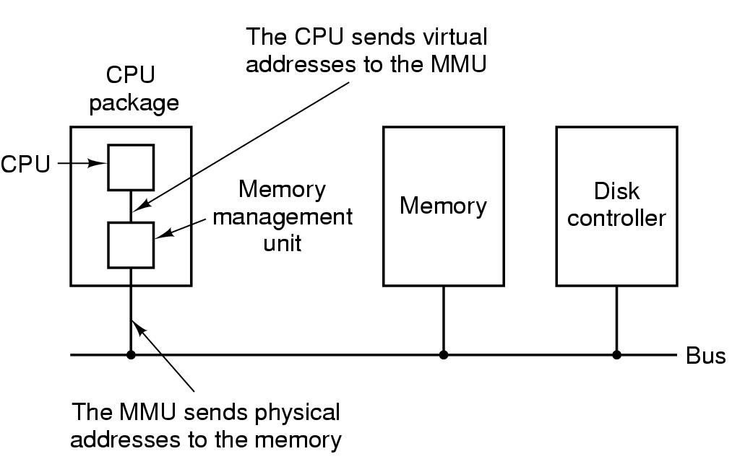
Virtual Memory Memory Management Unit (MMU)
Tanenbaum, Fig. 3-8.

Slide 9
Memory management unit ánh xạ địa chỉ ảo -> Memory.

Slide 10
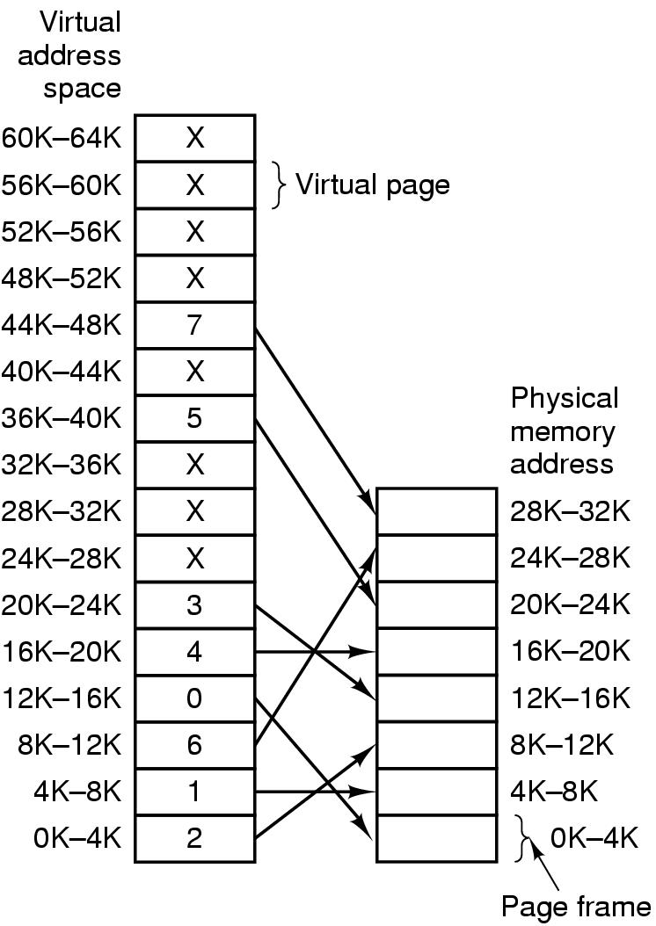
Virtual Memory Paging
Virtual address space đơn vị page
Is divided into fixed-size units called pages
pages from 0 to AddressSpaceSize / PageSize - 1
The physical memory
Is divided up into units of the same size corresponding in the physical memory called page frames
page frames from 0 to PhysicalMemSize / PageFrames - 1
Pages and frames are the same size
PageSize is typically be a value between 512 bytes and 64KB
Transfers between RAM and disk are in units of a page
Tanenbaum, Fig. 3-9.

Slide 11
Có số = tham chiếu
X: rỗng, ko có tham chiếu

Slide 12
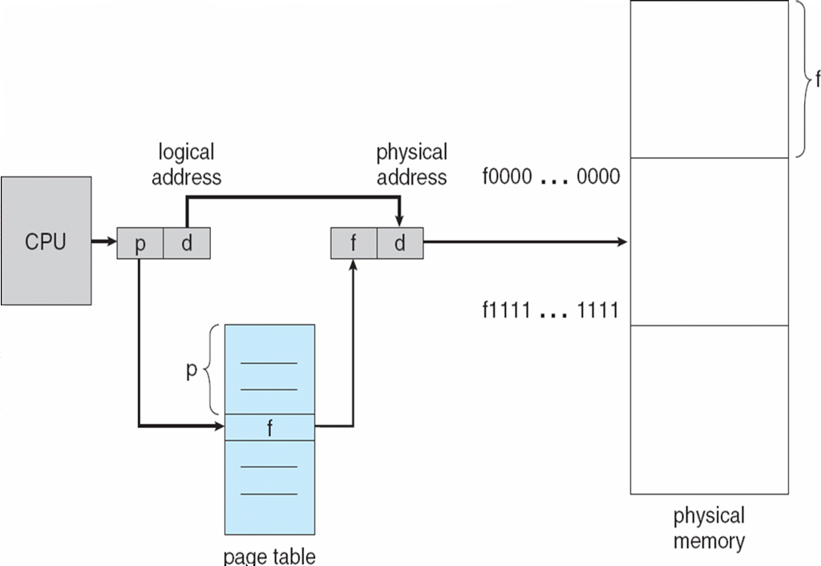
Virtual Memory Paging
In traditional, the paging has been handled by hardware
The virtual (logical) address is divided into 2 parts
a virtual page (p)
a page offset (d)
The p is used indexed into the page table that maps the page frame (f) in memory
The f is combined with d to define the physical memory address

Slide 13
Virtual Memory Paging – General formula
Assume
s is a page size
[p] = virtual address/s
→ d = virtual address – p x s
f is a page frame mapping page p
→ physical addr = f x s + d
VD: s = 4K
P ( thứ tự) = 16K / 4 = 4 (ô 0)
Tanenbaum, Fig. 3-9.

Slide 14
Virtual Memory Paging
move REG, 0
→ move REG, 8192
virtual address 0 is sent to the MMU
= (virtual page 0, offset 0)
virtual page 0 mapping is page frame 2
physical address 8192 (8K)
= (page frames 2, offset 0)
→Memory processes at address 8192
move REG, 20500
→ move REG, 12308: địa chỉ real
virtual address 20500 (20K)
= (virtual page 5, offset 20)
virtual page 5 mapping is page frame 3
physical address 12308 (12K)
= (page frame 3, offset 20)
Tanenbaum, Fig. 3-9.
Notes:
s =4096
p = 20500/ 4096 =5
d = 20500 - (5*4096) =20
Physical = 3*4096+20
14

Slide 15
Virtual Memory Paging
Problems
Only some virtual pages are mapped onto physical memory (e.g 16 pages maps 8 page frames)
→ virtual address space is larger than the physical memory
Present/Absent bit
Keeps track of which pages are physically present in memory
Page fault
a trap into the OS because of a reference to an address located in a page not in memory
generated by the MMU
result in a swap between physical memory and disk
the referenced page is loaded from disk into memory
the trapped instruction is re-executed

Slide 16
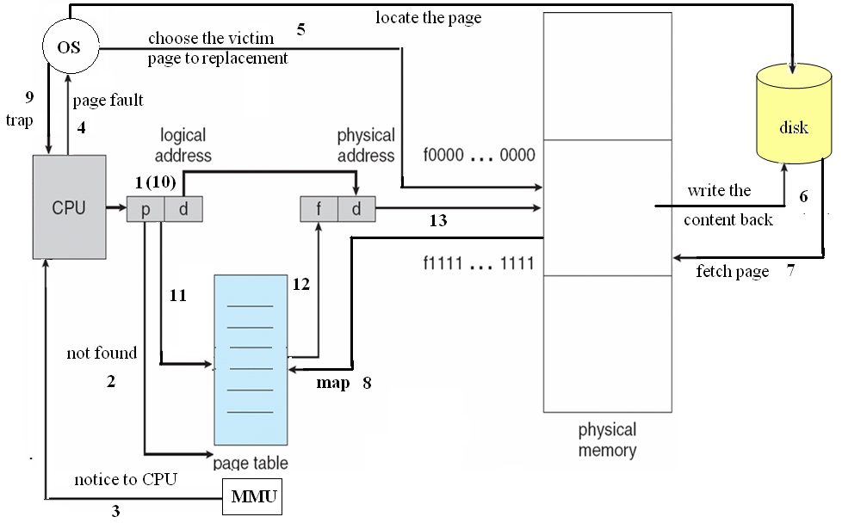
Virtual Memory Paging
Tìm Page thay thế

Slide 17
Virtual Memory Paging
Example
MOV REG, 32780 (32K)
virtual address 8
=(virtual page 8, offset 12)
virtual address 8 is unmapped with any page frame
→ the page fault is executed
OS decided to evict page frame 1
OS load page 8 at page frame 1 and make to changes to the MMU map
OS re-executed the instruction
virtual address 8 mapping is page frame 1
physical address 4108 (4K)
(page frame 1, offset 12)
Tanenbaum, Fig. 3-9.

Slide 18
Virtual Memory Page Tables
The mapping of virtual addresses onto physical addresses can be summarized as following
The virtual address is split into a virtual page number (high-order bits) and offset (low-order bits)
Ex: 16 bit address and a 4KB page size, 4 bit for 16 pages and 12 bit offset (0 to 4095)
The virtual page number is uses as an index into page table to find the entry for that virtual page
From the page table entry, the page frame number is found
The page frame number is attached to the high-order end of the offset, replacing the virtual page number, to form a physical address
Is the function with page number is argument and the page frame as result
Each process needs its own page table

Slide 19
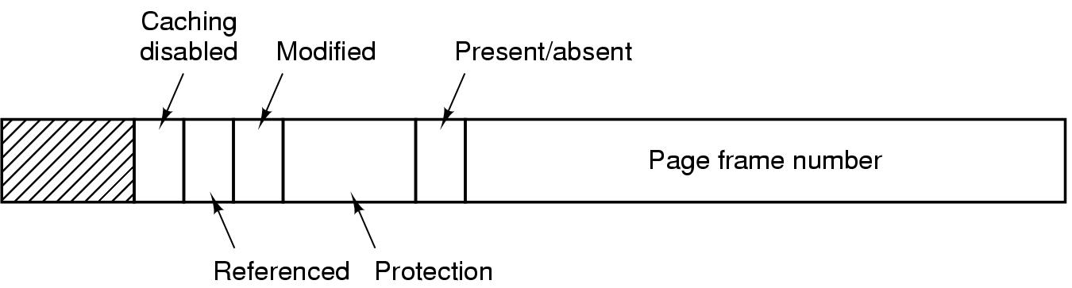
Virtual Memory Page Tables
Structure of a Page table entry
32 bits is a common size
Page frame number field
Present/absent bit
1: the entry is valid and can be used
0: the entry belongs is not currently in memory
Protection bits (sophisticated with 3 bits: reading, writing, executing of page)
1: read only
0: read/write
Modified and Referenced bits (keep track of page usage)
Modified: a page is written
Referenced: a page is referenced
Cached disable bit: allows caching to be disable for the page
Tanenbaum, Fig. 3-11.

Slide 20
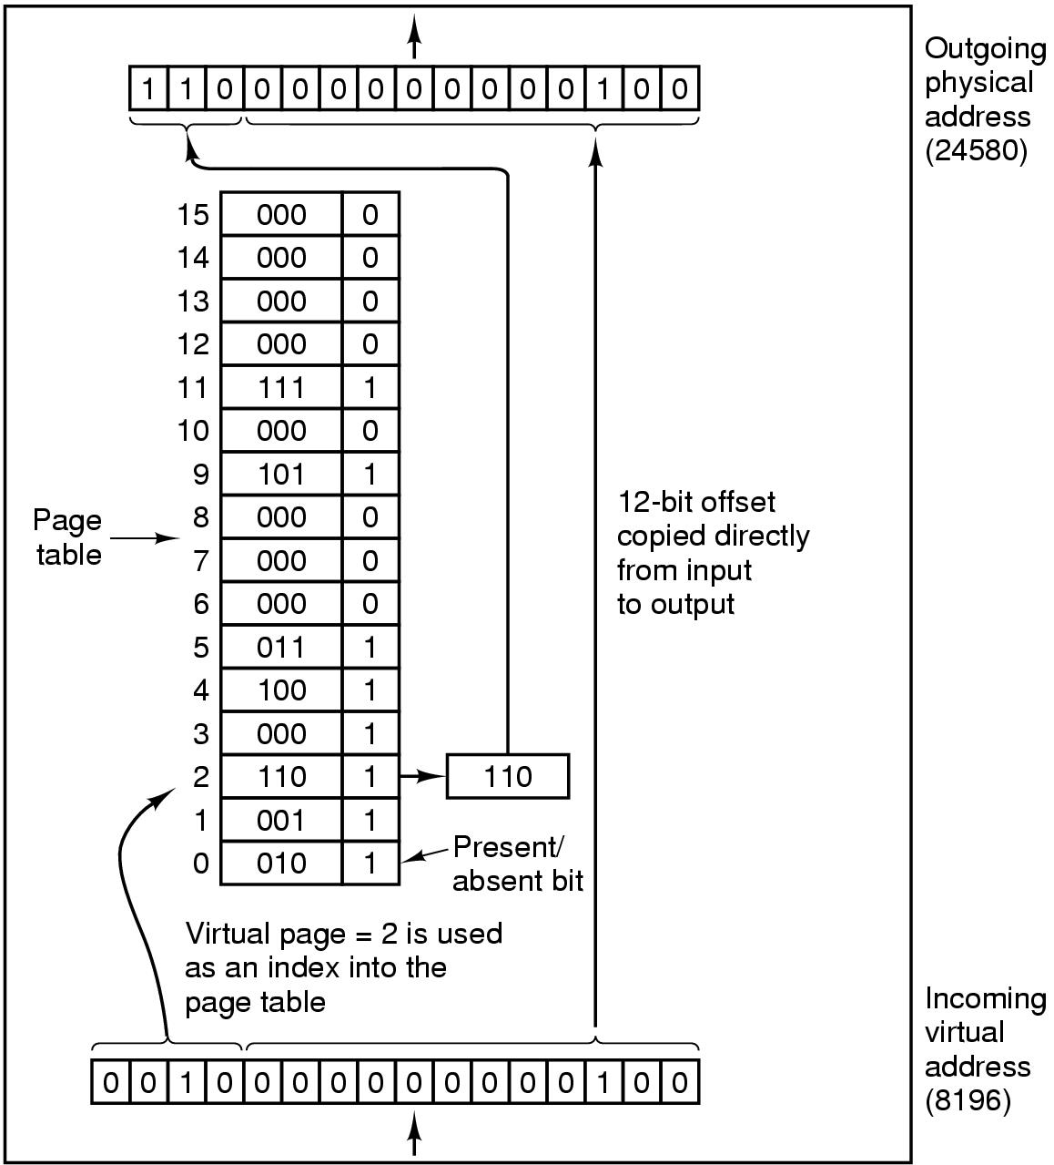
Virtual Memory Page Tables – Example
using page size is a power of 2
16 bit virtual address is split into a 4 bit page numbers (16 page) and 12 bit offset (4096 byte address)
12 bit – 3 bit page.
MOV REG, 8196
8196 in binary 0010000000000100
0010 = page number 2
000000000100 = offset 4
=(virtual page 2, offset 4)
Physical address 24580 (24K)
(page frame 6, offset 4)
f
d
Tanenbaum, Fig. 3-10.

Slide 21
Virtual Memory Page Tables – Example
Suppose a virtual address space of 2²⁸ words and the page size is 2¹² words. If the virtual address is 1234567 in Hexadecimal, what would be the page number in Hexadecimal?
0x1234567 = 19.088.743
2¹² = 4096
→ 19.088.743 / 4096 = 4660 = 0x1234

Slide 22
Virtual Memory Speeding up Paging
Paging issues
The mapping from virtual address to physical address must be fast
Avoid bottleneck
If an instruction execution takes 1 nsec, the page table lookup must be done in under 0.2 nsec
If the virtual address space is large, the page table will be large
32 bit virtual address, 4 KB page sizes → 1 million pages (entries)
Simplest design
Have a single page table consisting of an array of fast registers, with one entry for each virtual page, indexed by virtual page number
Page table is loaded from memory into registers (at starting up)
No more memory references needed (when processing)
Advantages: no memory
Disadvantages:
Context switch is expensive (load entire table for each process)
Can apply to the small page table

Slide 23
Virtual Memory Speeding up Paging – Example
If there are 64 pages and the page size is 2048 words, what is the length of logical address?
64 pages = 2⁶ → 6 bits is used to manage number of page
2048 words = 2¹¹ → 11 bits used to manage page size
→ 17 bits are a result
If there are 128K pages and the page size is 32 K words, what is the length of logical address?
128K pages = 2¹⁷ → 17 bits is used to manage number of page
32K words = 32.768 words = 2¹⁵ → 15 bits used to manage page size
→ 32 bits are a result

Slide 24
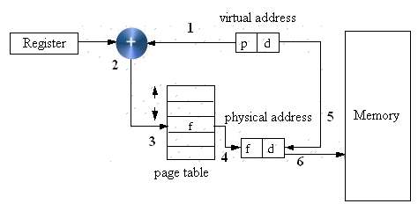
Virtual Memory Speeding up Paging
Single Register
Page table can be entirely in memory
A single register points to the start of page table
This register may be located in PCB
When the process start, this register must be reloaded
This allows the virtual to physical map to be changed at a context switch by reloading one register
Advantages: Context switch is fast (reloaded one register)
Disadvantages: more references to the memory for reading page table entries (slow)

Slide 25
Virtual Memory Translation Lookaside Buffers (TLB)
Problem
The CPU makes a memory access using a virtual address. It requires an address translation to a real address
This needs accesses to the page table which is itself in memory i.e. every virtual memory access requires two (or more if 2 level table) real accesses
→Slow
Observations
Keeping the page tables in memory reduce drastically the performance
Make large number of references to a small number of pages
Solution: using TLB or associative memory
A small fast hardware for mapping virtual addresses to physical addresses without going through the page table
This device is usually inside in MMU and consists of a small number of entries (usually less than 64) → maps only a small number of virtual pages
A TLB entry contains information about one page (valid bit (that presents the page in use or not use), page number, modified bit, protection bit, page frame)
These fields have a one-to-one correspondence with the fields in page table, except for the page number, which is not need in the page table
A TLB can be also implemented in software

Slide 26
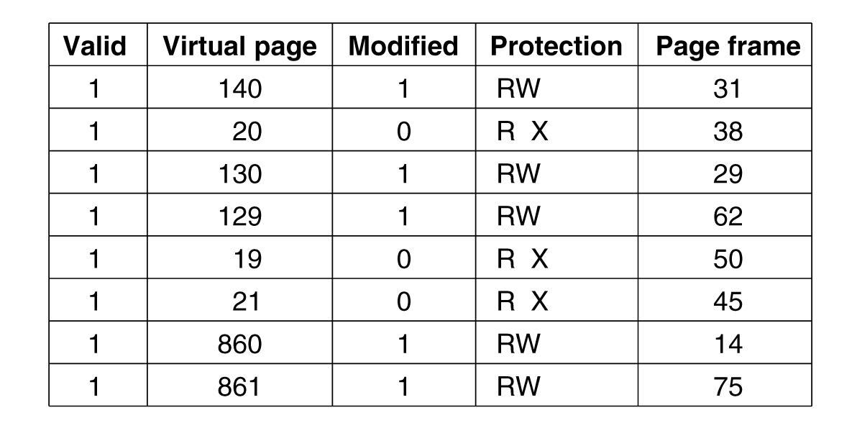
Virtual Memory Translation Lookaside Buffers (TLB)
Tanenbaum, Fig. 3-12.

Slide 27
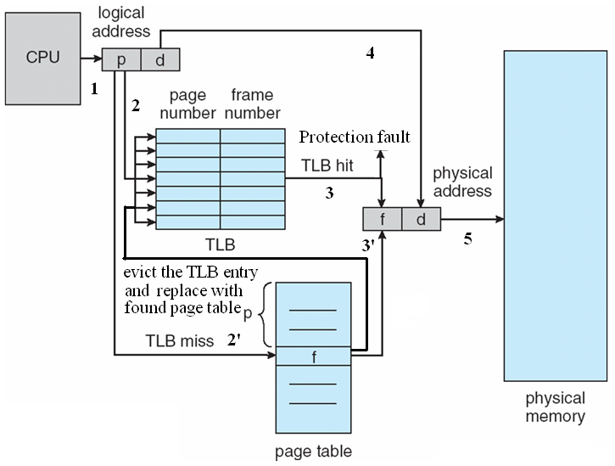
Virtual Memory Translation Lookaside Buffers (TLB)
How to the TLB do

Slide 28
Virtual Memory Translation Lookaside Buffers (TLB)
How to the TLB do (cont)
When the virtual address is presented in MMU for translation
The hardware search entire TLB to find if the entry is matched
If so,
If the access does not violate the protection, the page frame is taken without going to the page table
Otherwise, the protection fault can occur
Otherwise,
The MMU detects the miss and does an ordinary page table lookup
The MMU evicts one of the entries from the TLB and replaces it with the page table just looked up
After the page frame is defined, the physical memory can be accessed

Slide 29
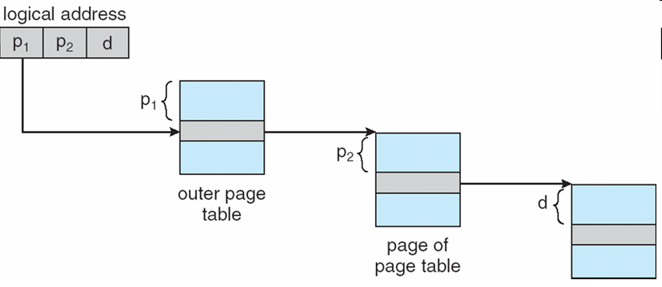
Virtual Memory Multilevel Page Tables
Problem
Most modern computer support a large logical address (2³² to 2⁶⁴)
→ The page table become excessive large and the developer would not want to allocate it in memory at a/ all time
Solution
Divide the page table into smaller pieces
The multilevel Page tables is used
To avoid keeping all the page tables in memory all the time
The main idea is “Paging the page table”
The virtual address is divided two part: 20 bit page number, and 12 bit offset
Since the page table is paged again, the page number is divided two into: 10 bit page number (PT1), and 10 bit offset (PT2)

Slide 30
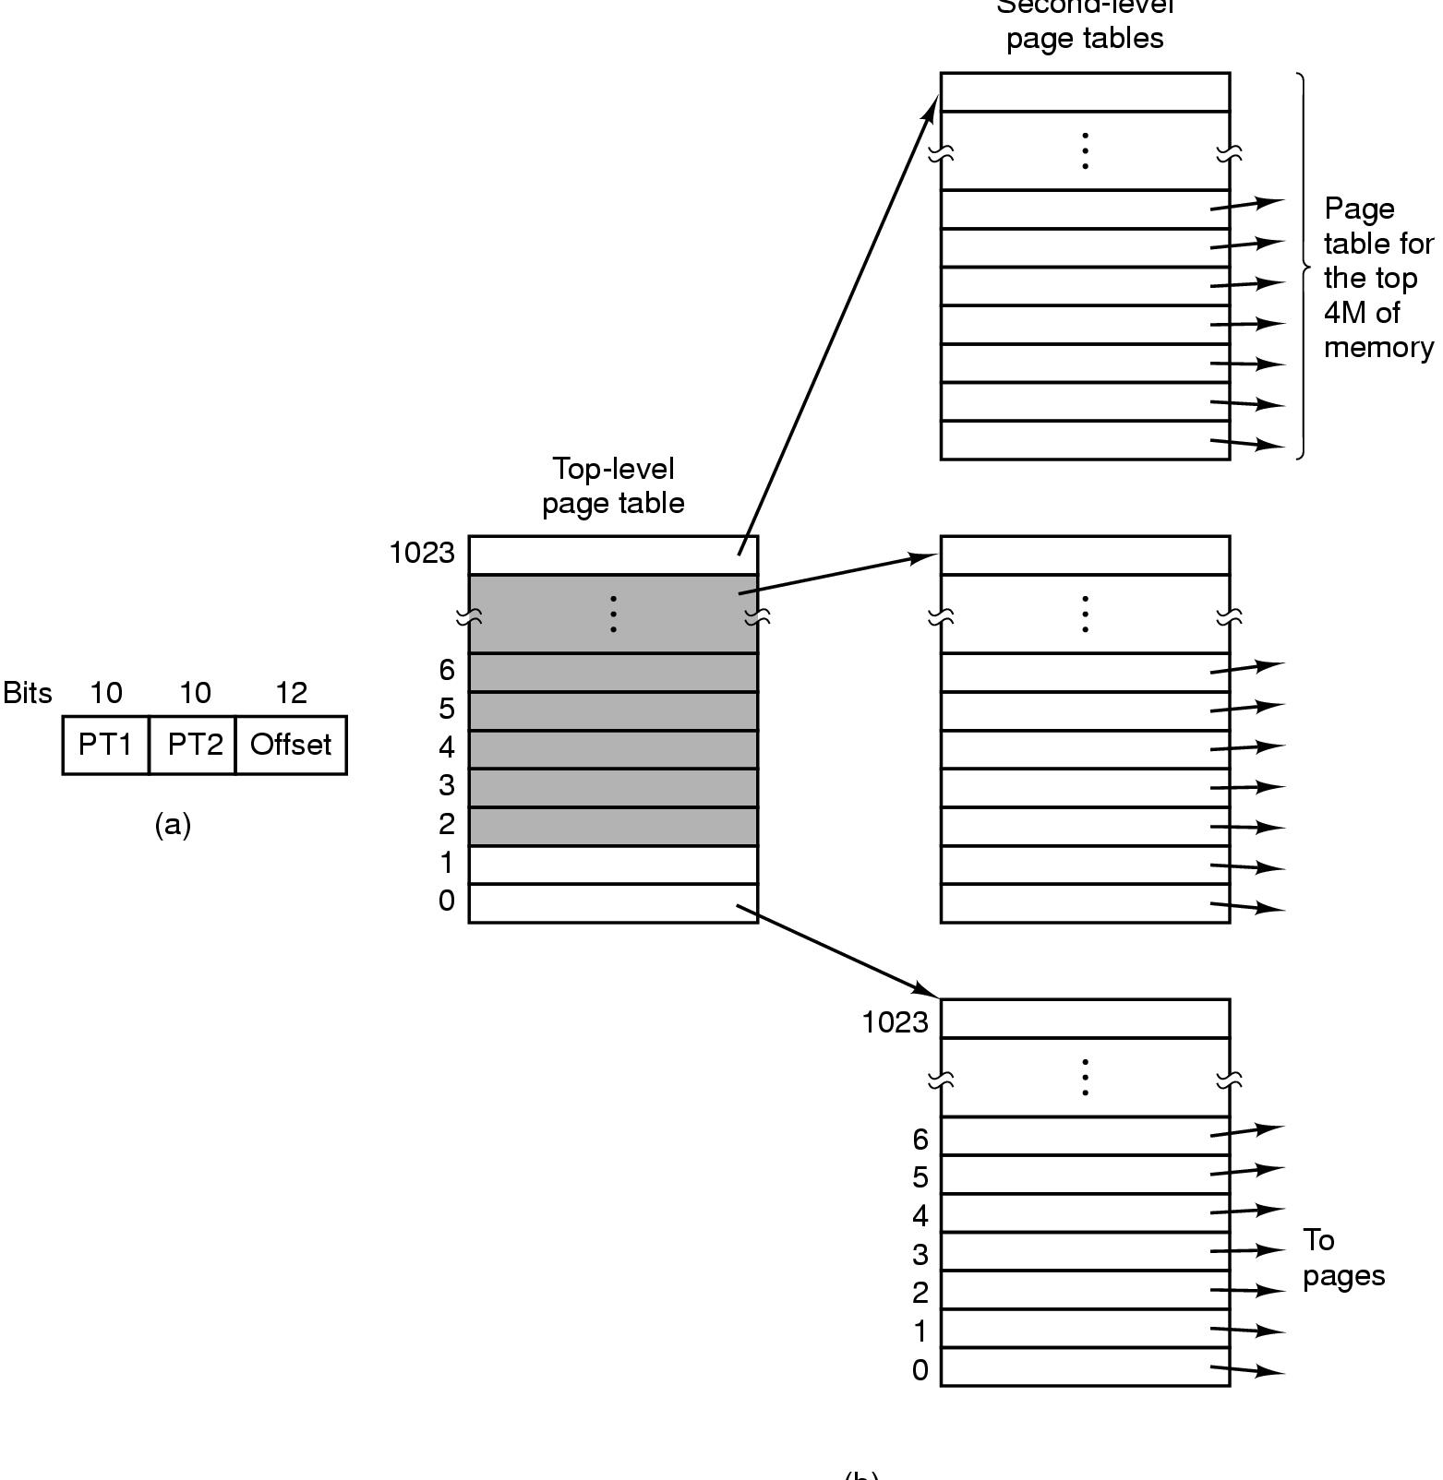
Virtual Memory Multilevel Page Tables
32 bit virtual addresses
10 bits – PT1
10 bits – PT2
12 bits – offset
Page size = 4KB
No. of pages = 2¹⁰
Top-level page table – 1024 entries
An entry → 4MB
Second-level page table – 1024 entries
An entry → 4KB
Tanenbaum, Fig. 3-13.

Slide 31
Virtual Memory Multilevel Page Tables
How does it work
First, the MMU extracts the PT1 field and uses this value as an index into the top level page table
The entry located by indexing into the top-level page table yields the address or page frame number of a second-level page table
The PT2 field is used as an index into the selected second-level page table to find the page frame number for the page itself
Ex:
32 bit virtual address 0x00403004 (=4.206.596), 12.292 bytes data
PT1=1 → 4M:8M (=4.194.304 bytes)
PT2=3 → 12KB:16KB(=12.288 byte : 16383 bytes)
The virtual address is (4.194.304+12.288 = 4.206.592 to 4.210.687) and Offset = 4
→The page frame PT1 = 1, The page frame of PT2 = 0, thus the physical address is 4
If the page is not in memory, causing a page fault
If the page is in memory, the page frame number taken from the second level page table combined with the offset to construct the physical address

Slide 32
Virtual Memory Inverted Page Table
Problem
64 bit computer, with 4KB pages→2⁵² page table entries, with 8 bytes/entry → over 30 million GB per page table (very large)
Solution
Using the inverted page table for handling large address spaces
Each one entry in table represents page frame in real memory (vs. each one entry per page of virtual address space in page table)
An entry contains the pair (process n, virtual page p) is located in page frame
When the process (n) references the virtual address
The virtual address is decoupled two parts (virtual page p, offset)
The hardware search entire the inverted page table for the entry (n, p)
If the entry is found, the entry position is the page frame. Then, the physical memory is generated by adding the first address of detected page frame combined with the offset
Otherwise, the page fault occurs

Slide 33
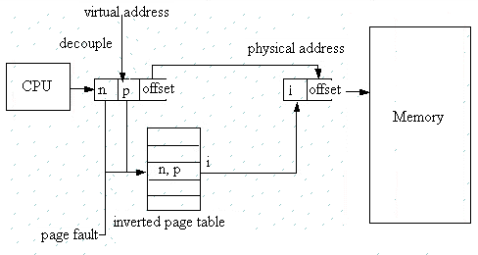
Virtual Memory Inverted Page Table

Slide 34
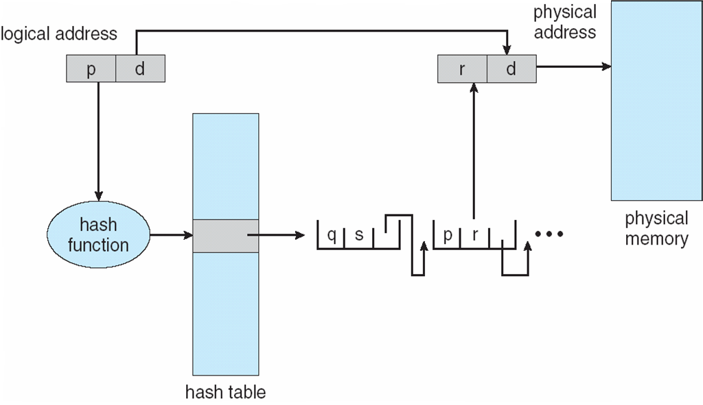
Virtual Memory Inverted Page Table
Advantages
64bit virtual addresses, a 4KB page, 1GB RAM, an inverted table only required 262,144 entries (saving vast amount of space)
Disadvantages
The virtual-to-physical translation becomes much harder and slower
Searching the entire table at every memory reference
Practically: use of TLB and hash tables (searching in software)

Slide 35
Summary
Virtual Memory
Q&A

Slide 36
Next Lecture
Page replacement Algorithms

